Slide 1
EBS & EFS
EBS – Elastic Block Storage
EFS – Elastic File System
EBS Intro
EFS Intro
Types of EBS
EBS Snapshots
EBS Volume Migration and Encryption
Raid configuration

Slide 2

EBS Intro
An EC2 machine loses its root volume (main drive) when it is manually terminated.
Unexpected terminations might happen from time to time (AWS would email you)
Sometimes, you need a way to store your instance data somewhere
An EBS (Elastic Block Store) Volume is a network drive you can attach to your instances while they run
It allows your instances to persist data
It’s a network drive (i.e. not a physical drive)
It’s locked to an Availability Zone (AZ)
Have a provisioned capacity (size in GBs, and IOPS)
SSD-backed volumes optimized for transactional workloads involving frequent read/write operations with small I/O size, where the dominant performance attribute is IOPS
HDD-backed volumes optimized for large streaming workloads where throughput (measured in MiB/s) is a better performance measure than IOPS

Slide 3
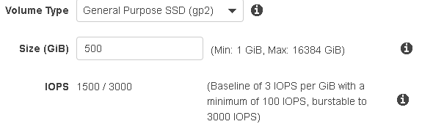
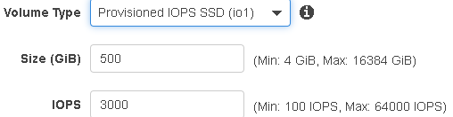
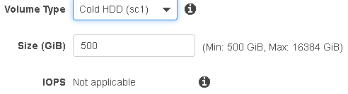
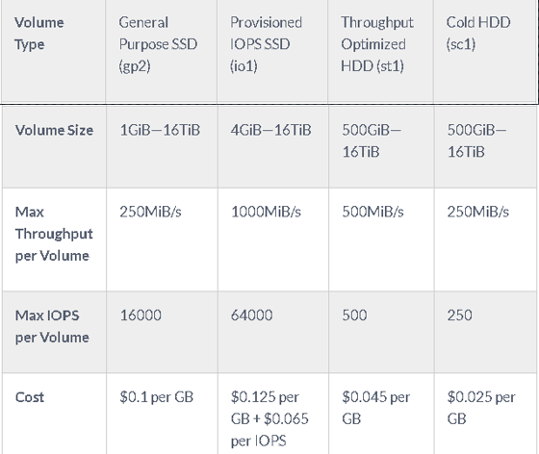
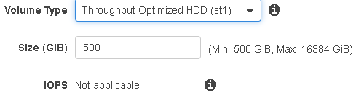
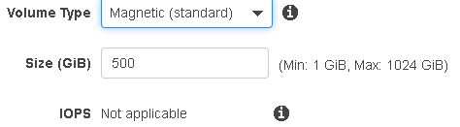
Types of EBS
General Purpose SSD (gp2)
Provisioned IOPS SSD (io1)
Cold HDD (sc1)
Throughput Optimized HDD (st1)
Magnetic (standard)
* Instance Store

Slide 4
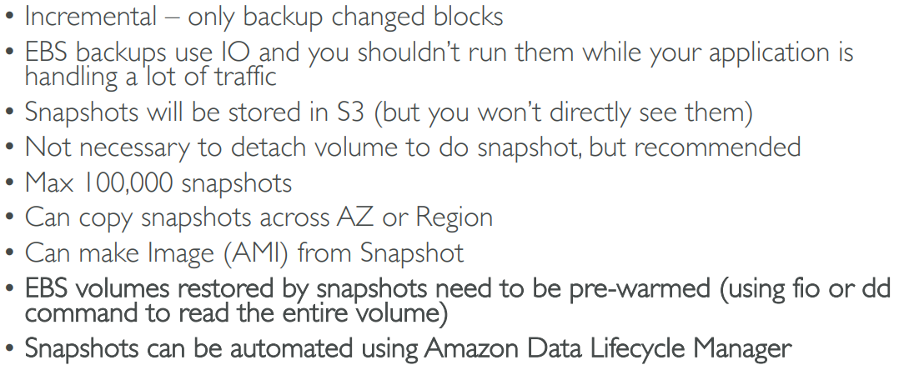
EBS Snapshots

Slide 5
EBS Volume Migration and Encryption
Migration is nothing but a copy of the snapshot to different region or AZ
EBS Encryption leverages keys from KMS (AES-256)
Copying an unencrypted snapshot allows encryption
Snapshots of encrypted volumes are encrypted

Slide 6
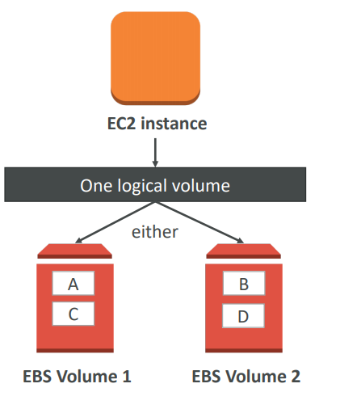
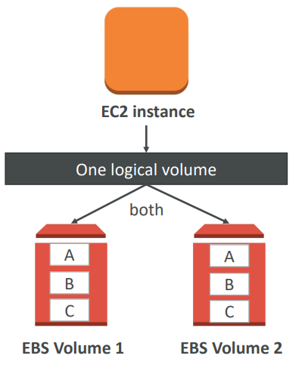
Raid configuration
RAID 0 (increase performance)
RAID 1 (increase fault tolerance)

Slide 7

EFS – Elastic File System
Managed NFS (network file system) that can be mounted on many EC2
EFS works with EC2 instances in multi-AZ
Highly available, scalable, expensive (3x gp2), pay per use
Use cases: content management, web serving, data sharing
Uses NFSv4.1 protocol
Uses security group to control access to EFS
Compatible with Linux based AMI (not Windows)
Encryption at rest using KMS File system scales automatically,
pay-per-use, no capacity planning

